Slide 1
E-Commerce Application

Slide 2
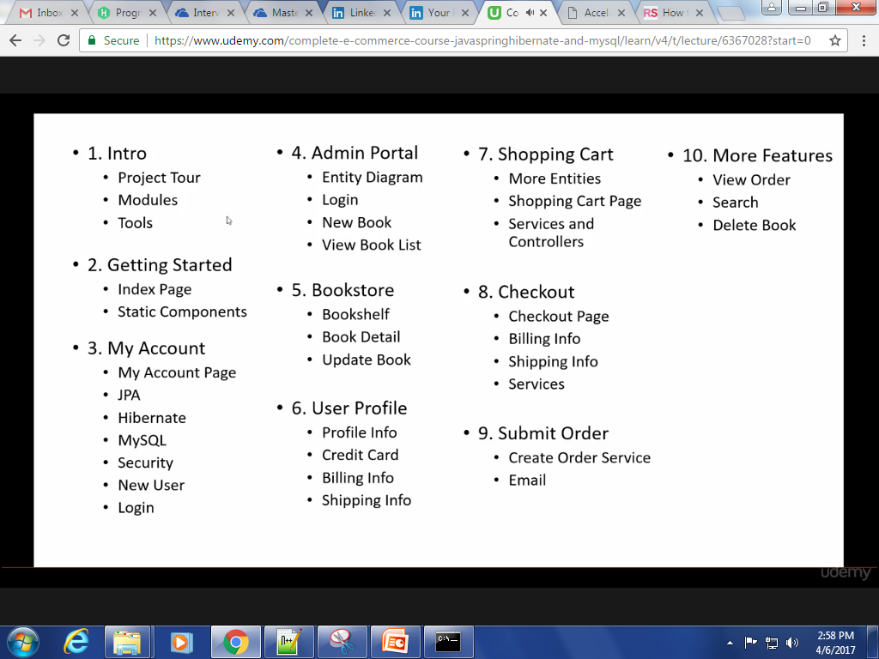
Course Overview

Slide 3
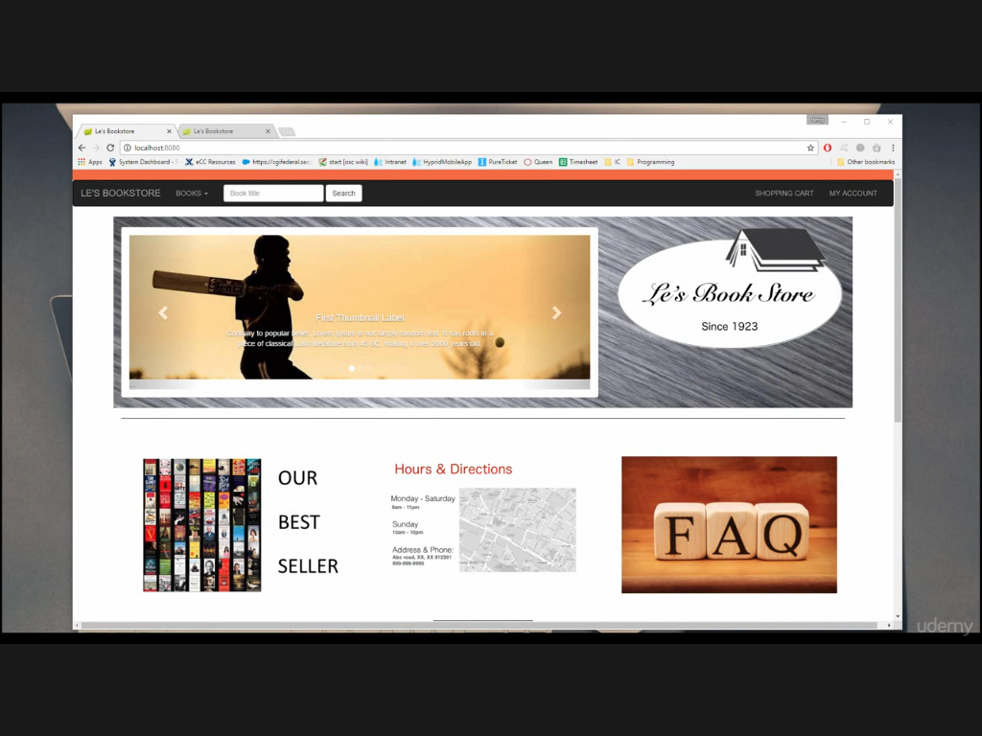
Project Tour

Slide 4
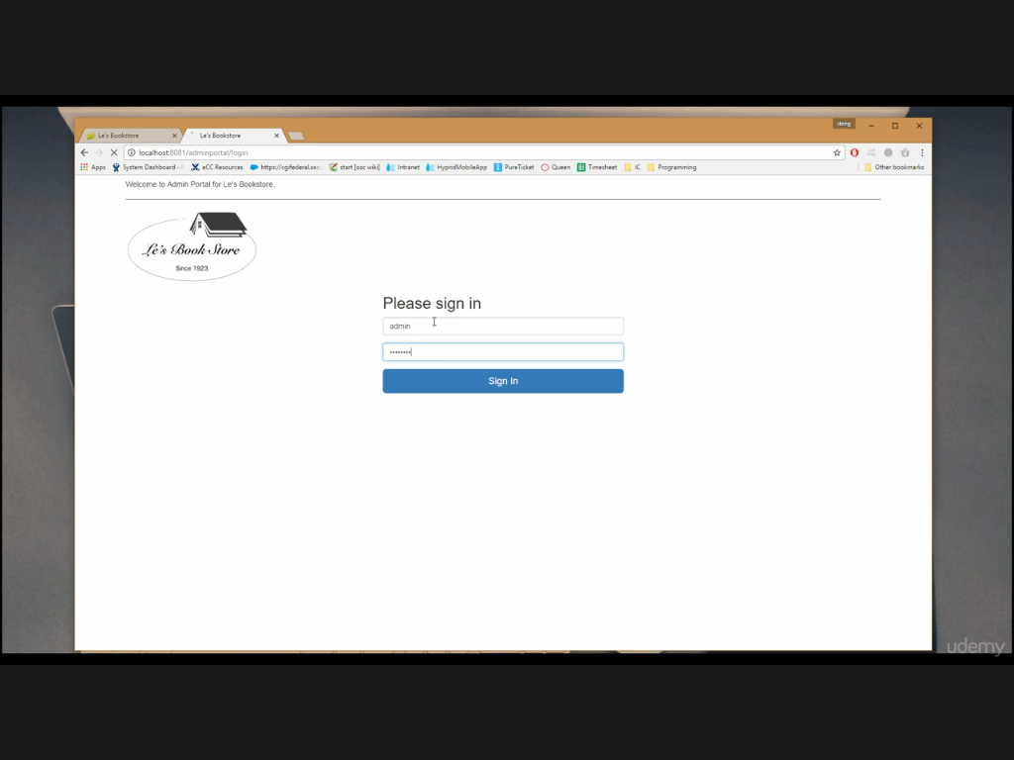

Slide 5
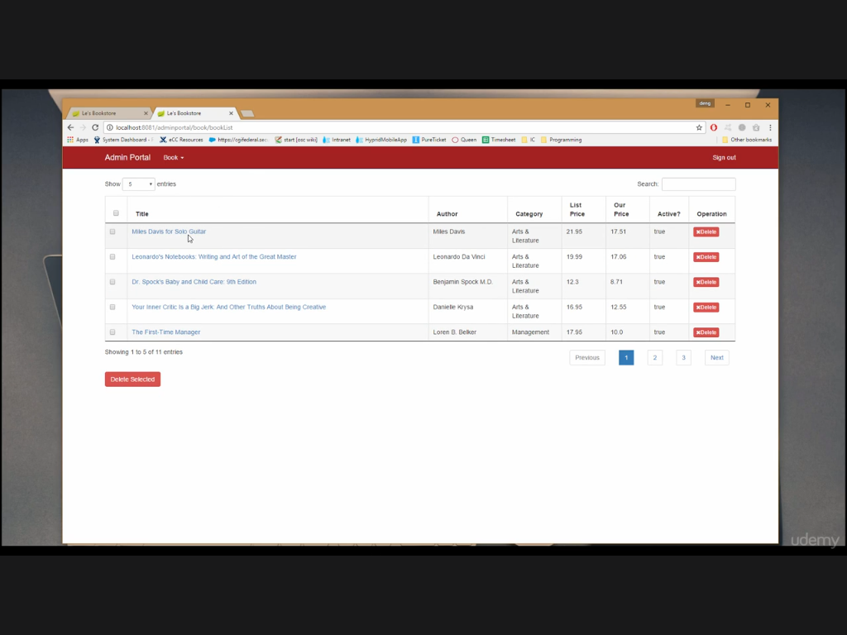

Slide 6
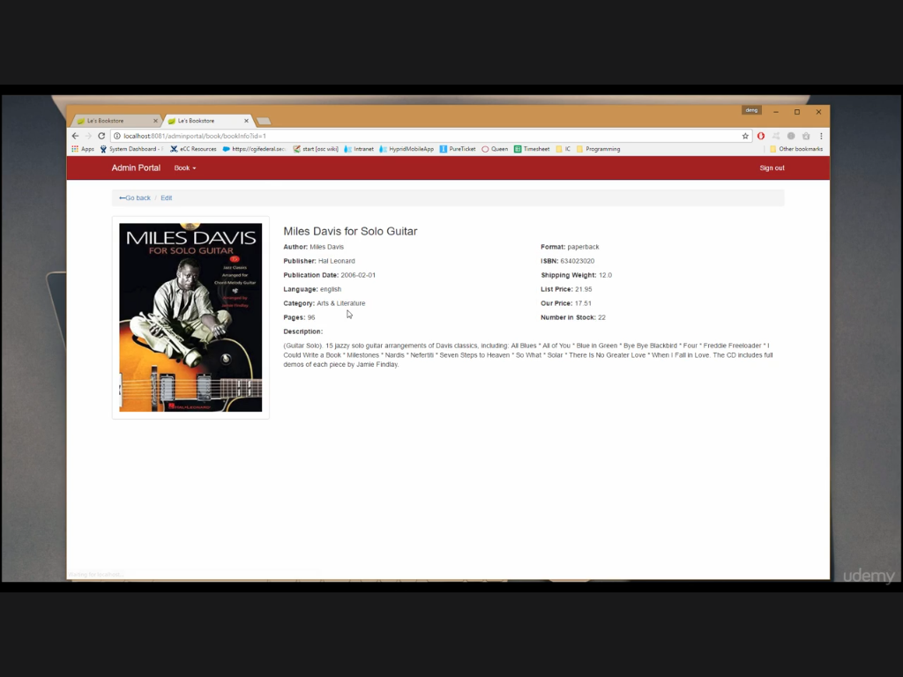

Slide 7
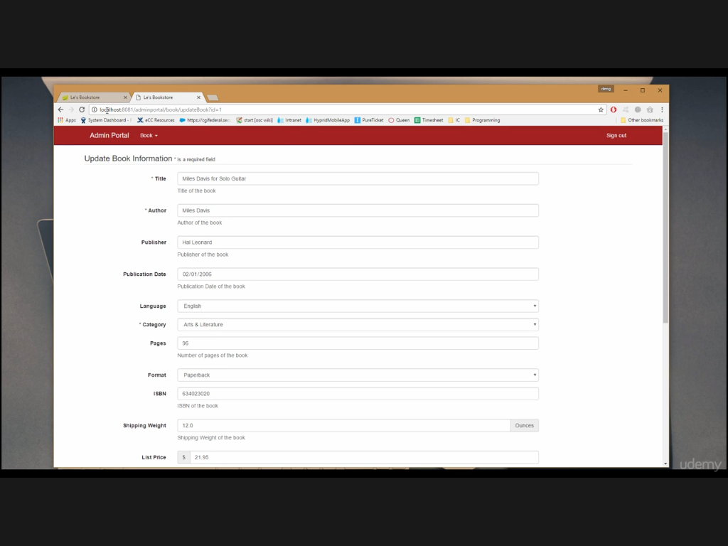

Slide 8
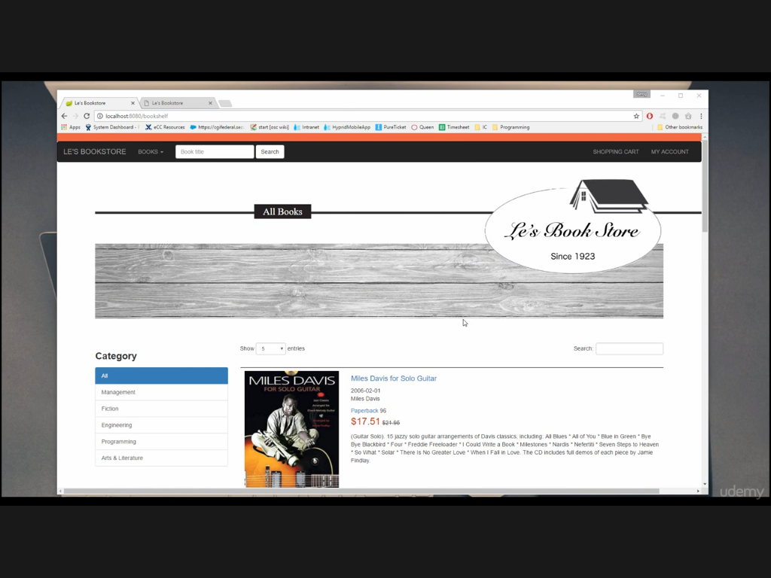

Slide 9
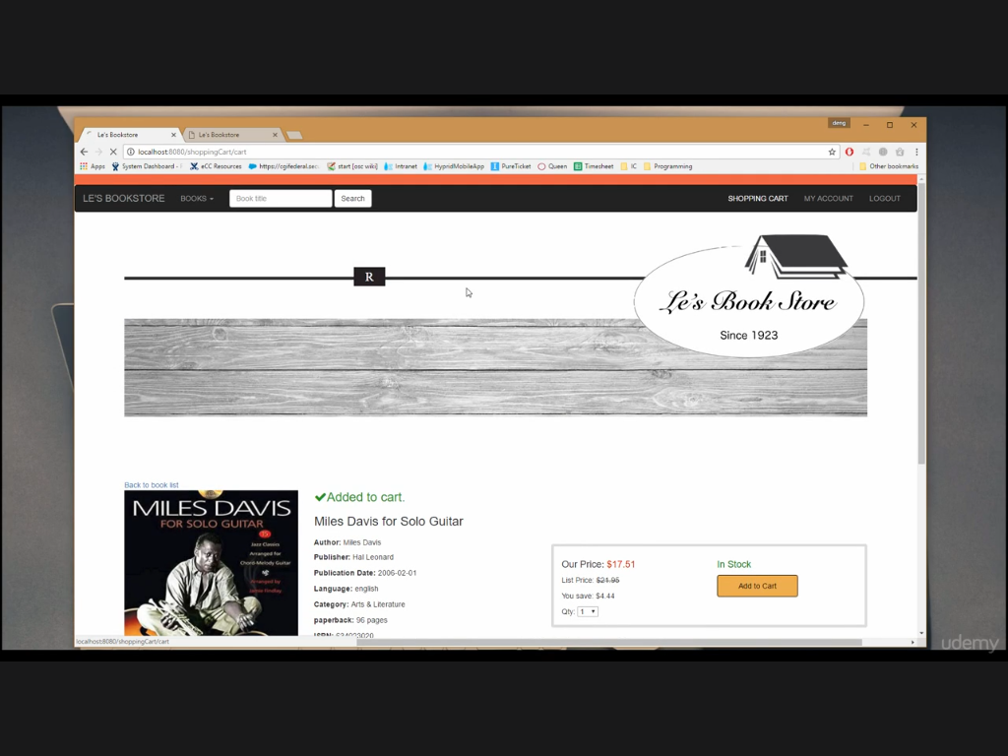

Slide 10
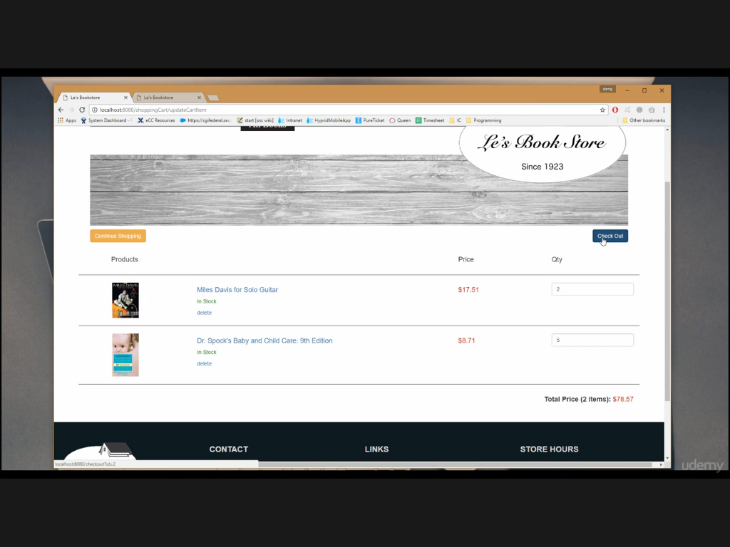

Slide 11
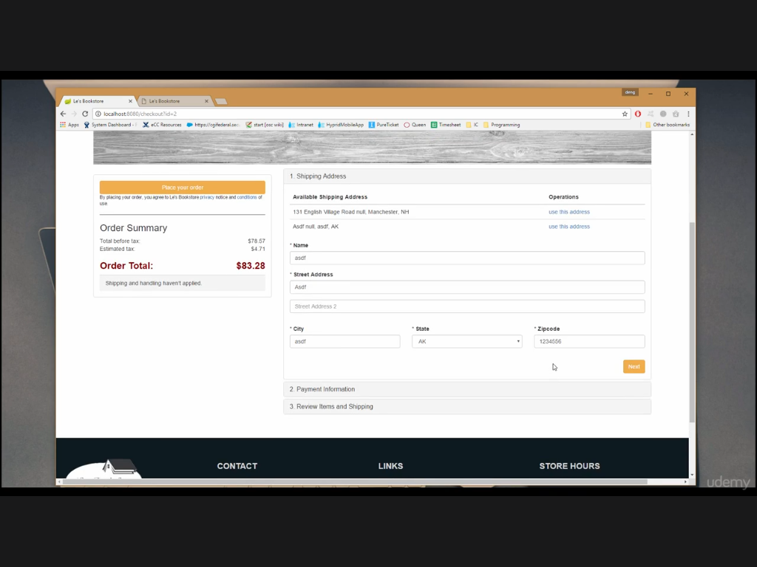

Slide 12
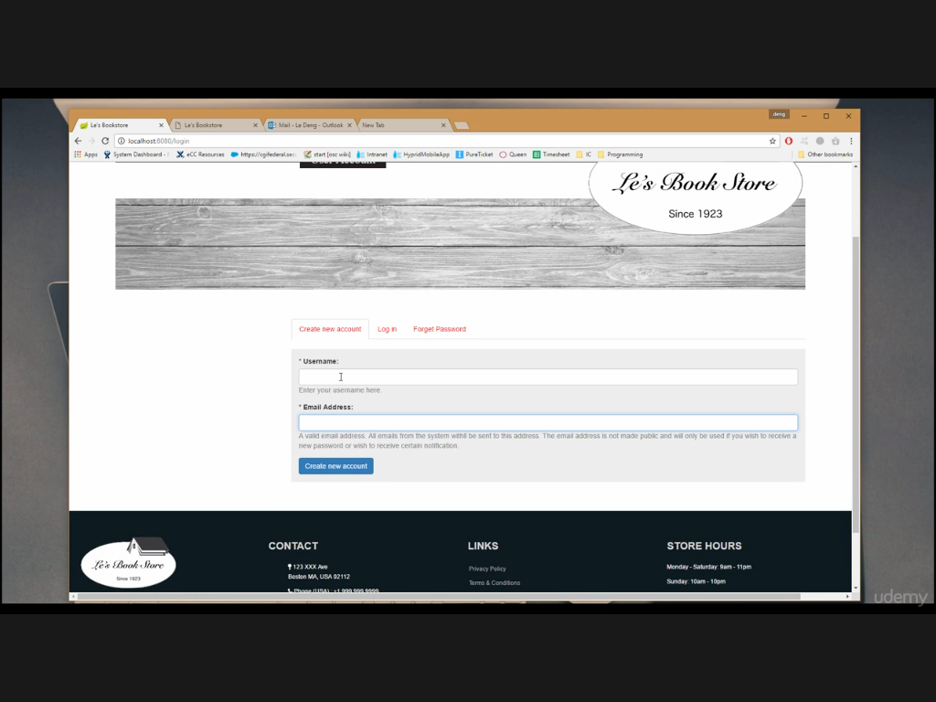

Slide 13
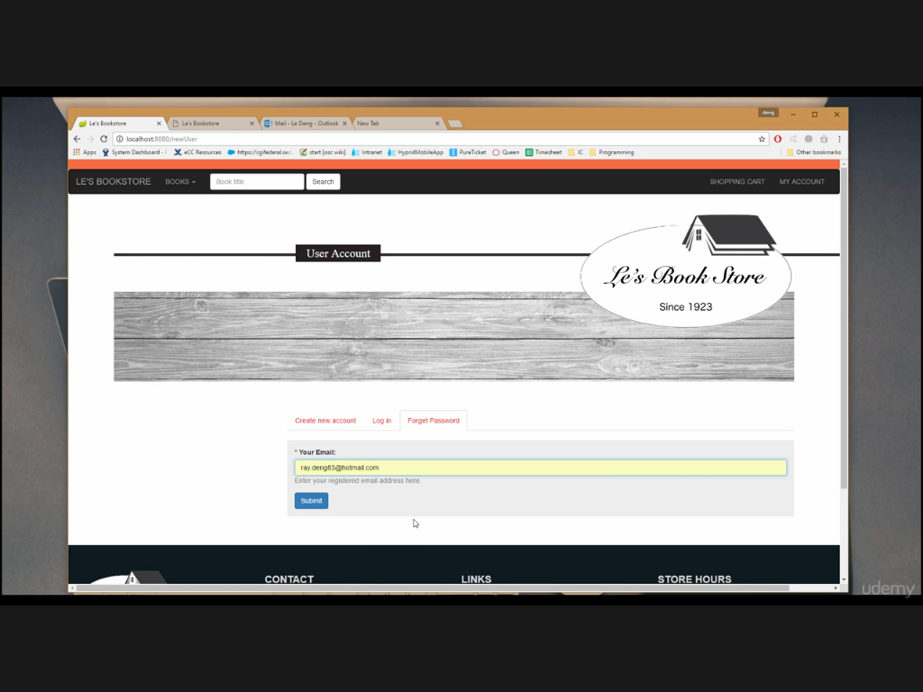

Slide 14
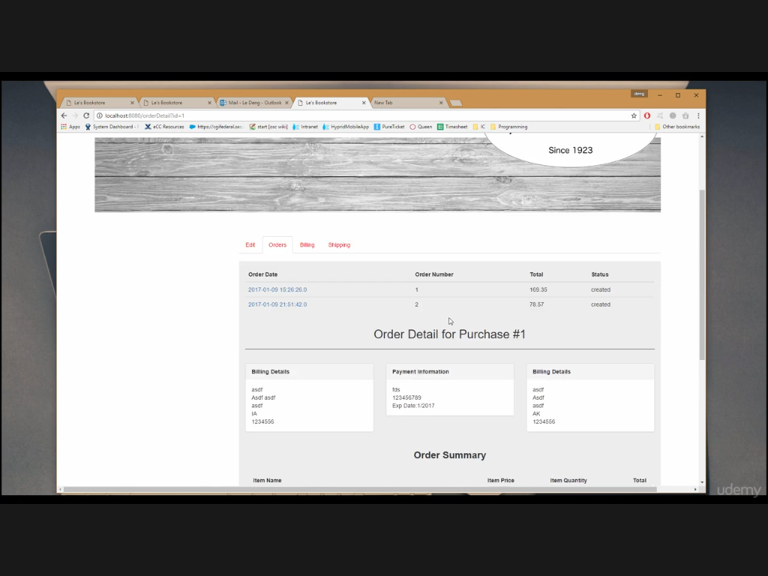

Slide 16
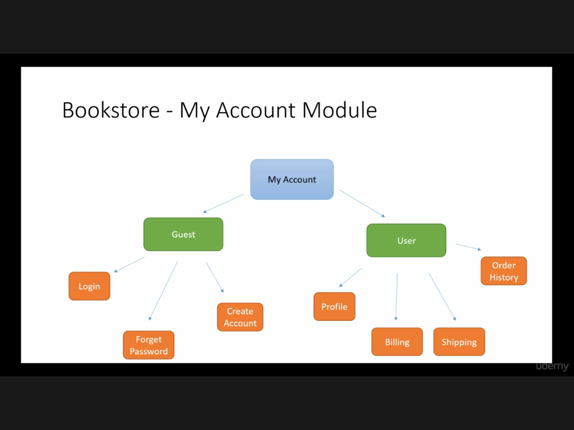
Project Modules

Slide 17
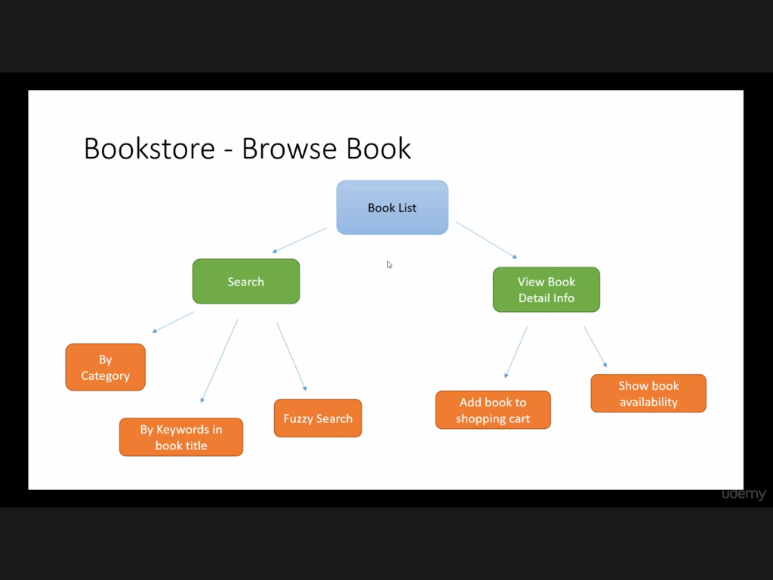

Slide 18
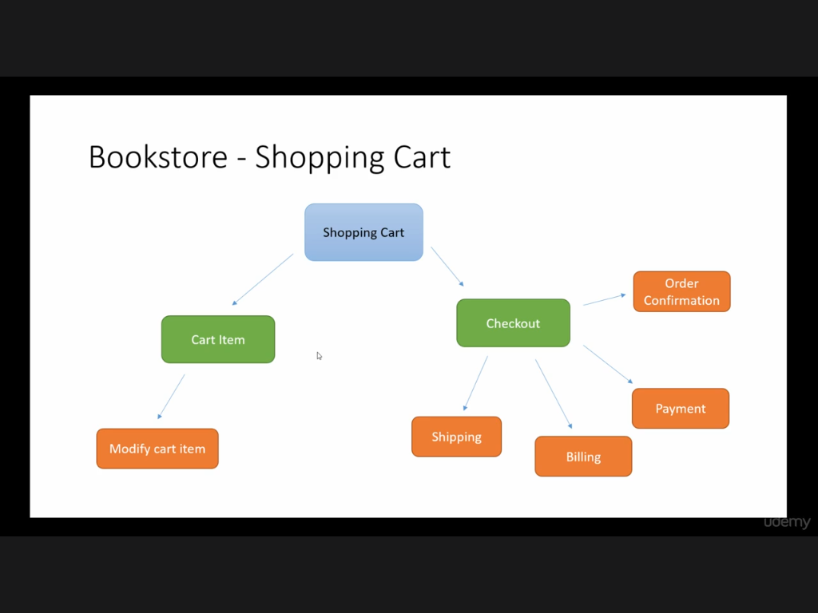

Slide 19
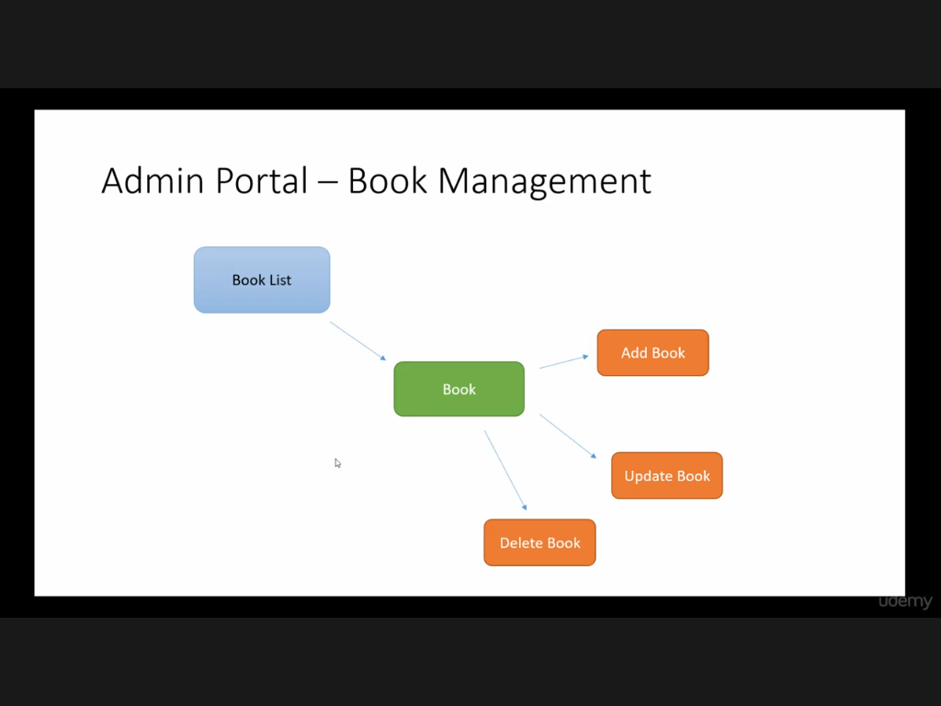

Slide 20
Tools We used
Java 1.8
Eclipse Neon
MySQL
MySQL Workbench 6.3
Sequel Pro(for Mac only)
Install Spring Plugin as shown in next slide.
Notes:
We will be covering Spring, Spring Boots, DB and Hibernate.

Slide 21
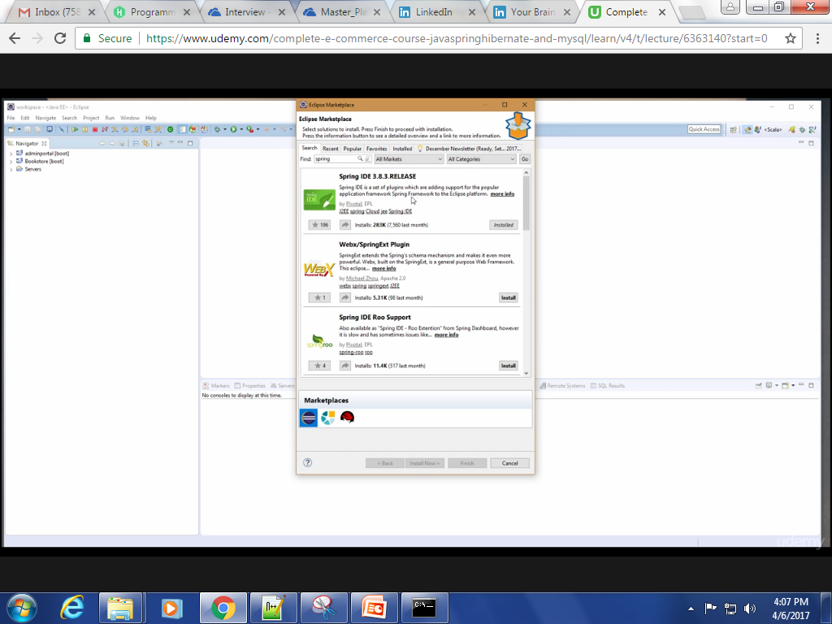
Install Spring Plugin like Spring IDE, Spring Tool Soot and Spring Source Tool

Slide 22
Getting Started
Section 2

Slide 23
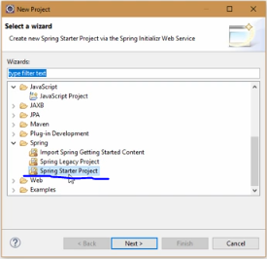
Start Project with Index Page

Slide 24
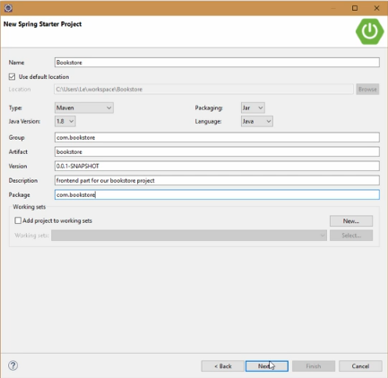

Slide 25
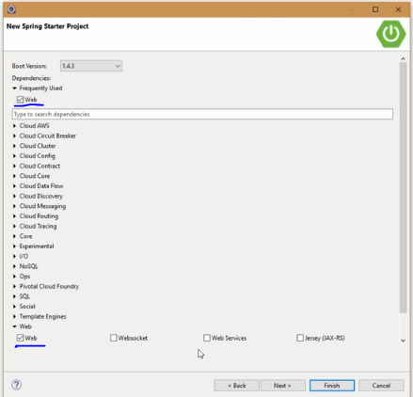

Slide 26
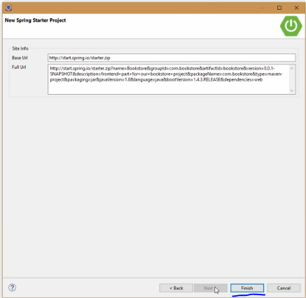

Slide 27
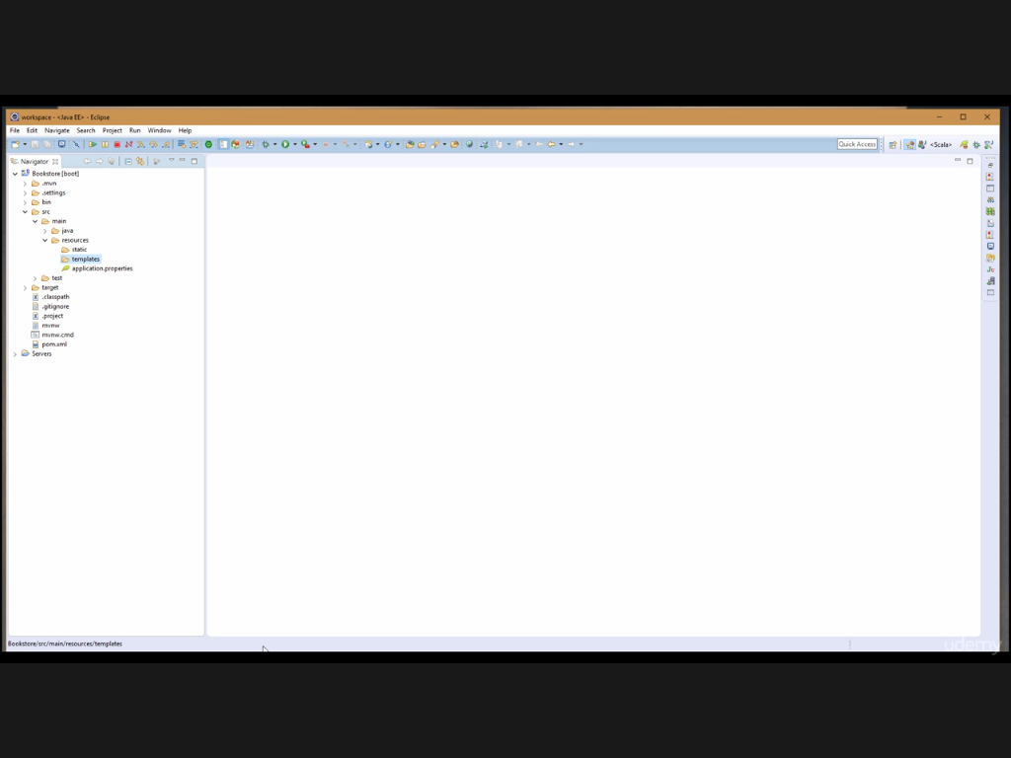

Slide 28
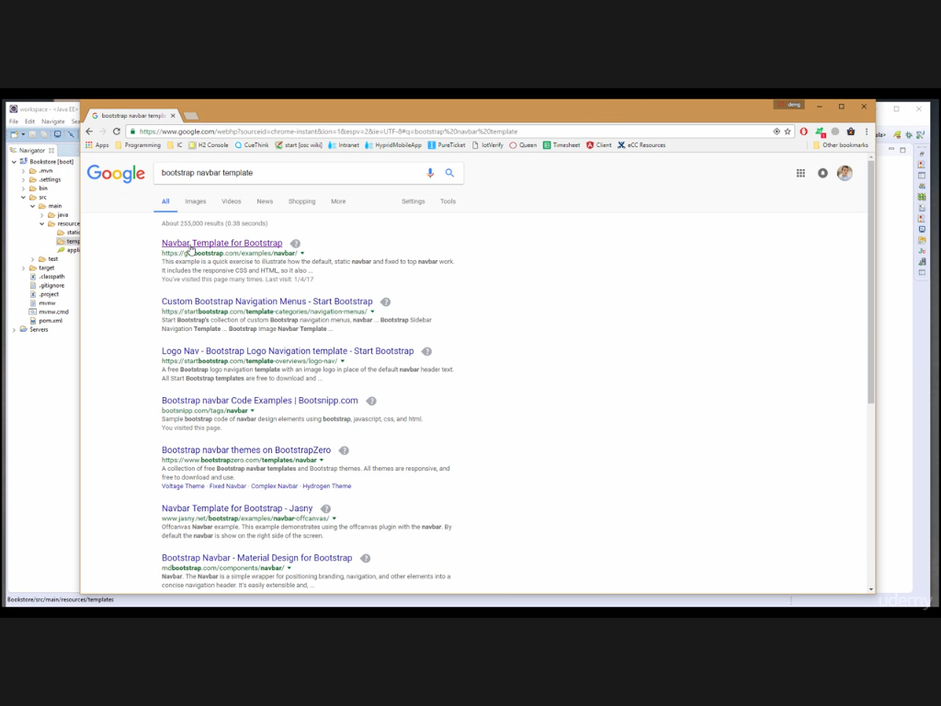

Slide 29
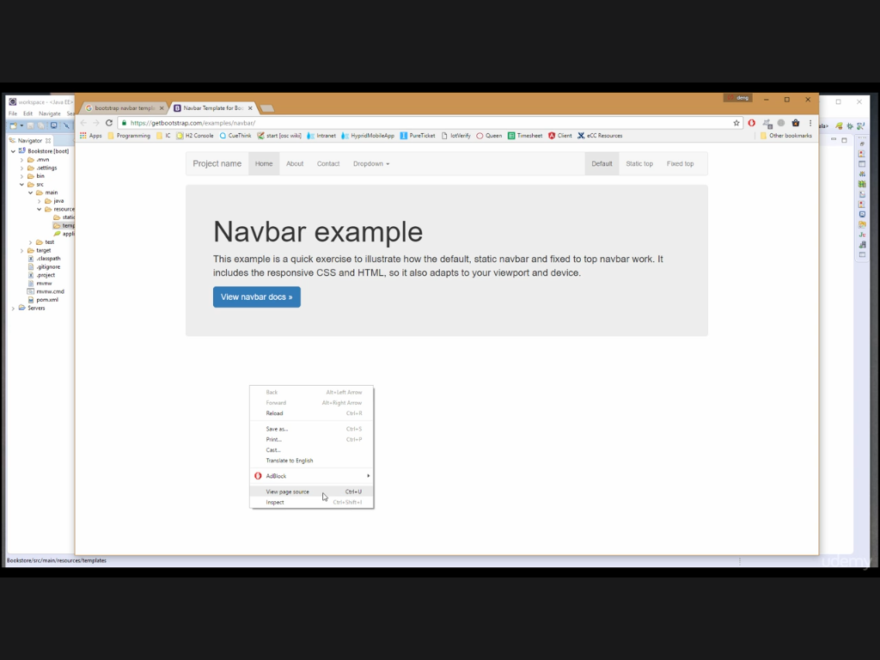
View Source

Slide 30
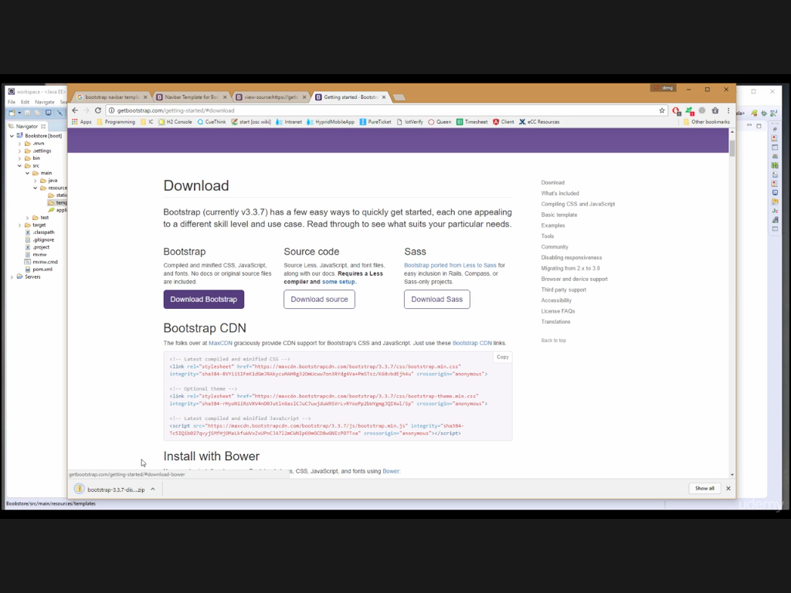

Slide 31
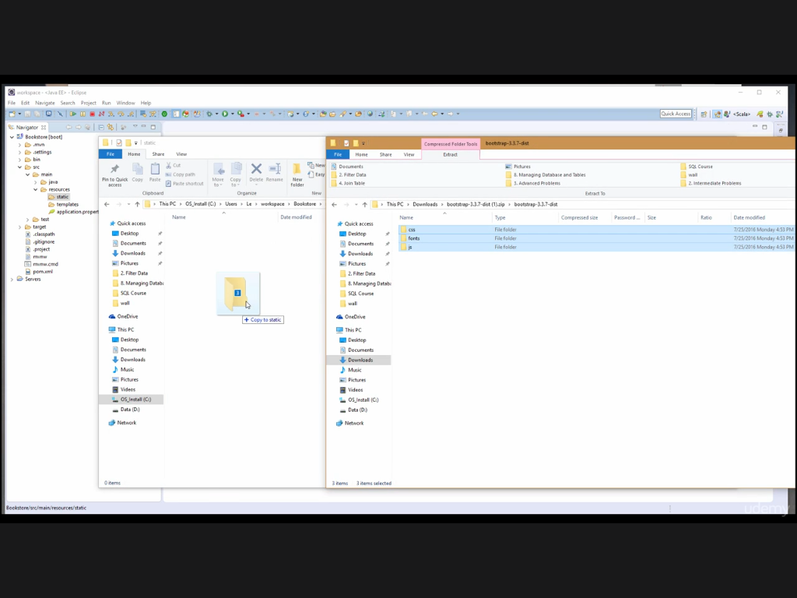

Slide 32
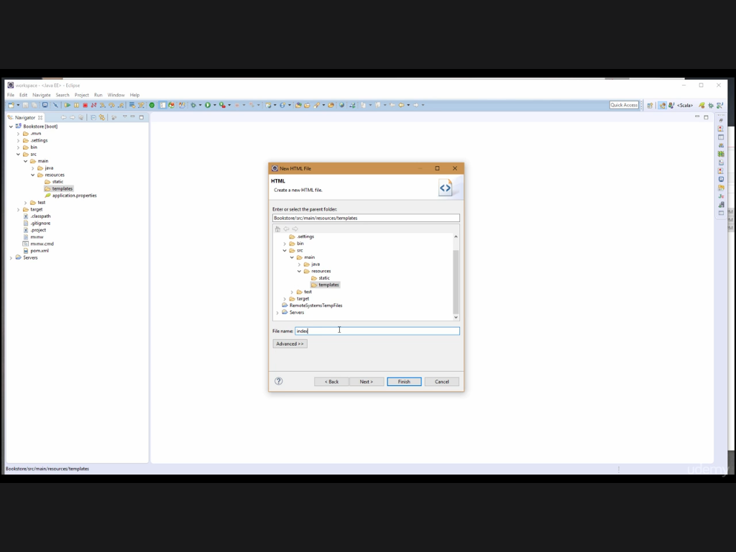

Slide 33
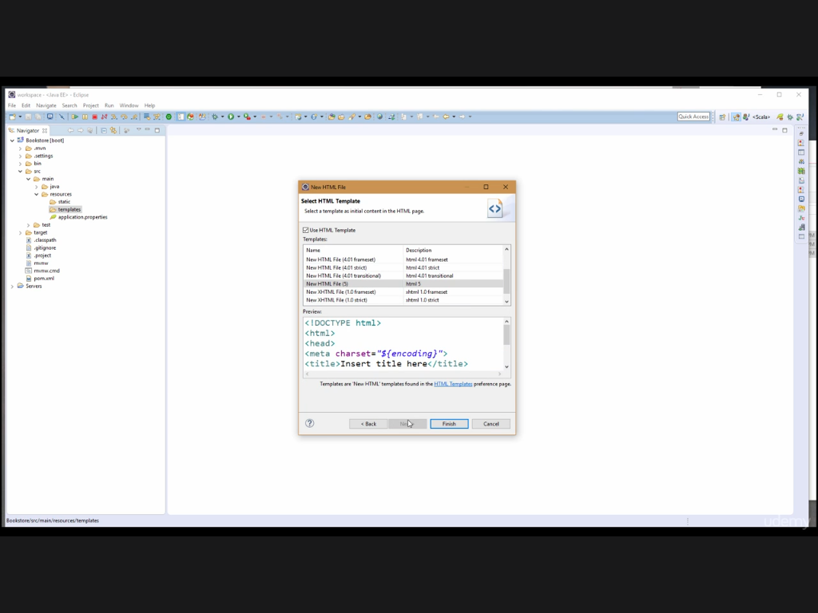

Slide 34
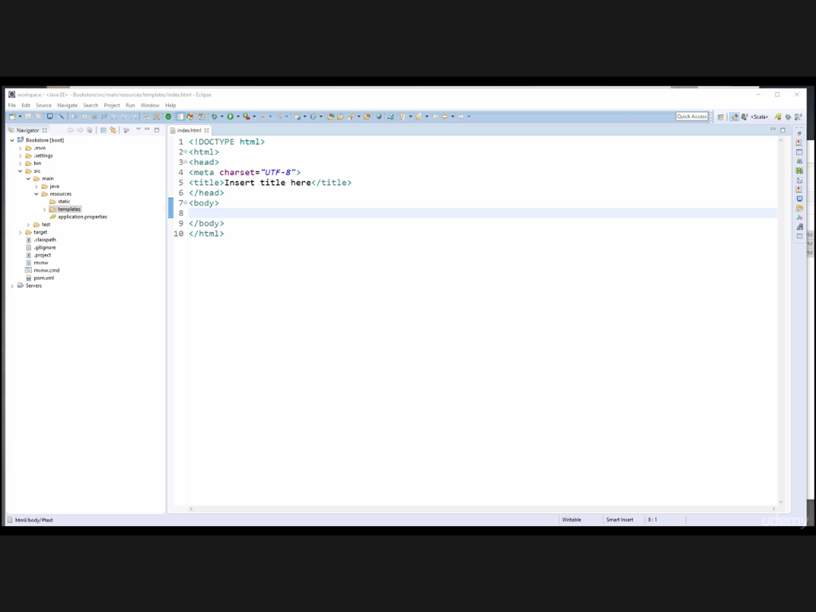

Slide 35
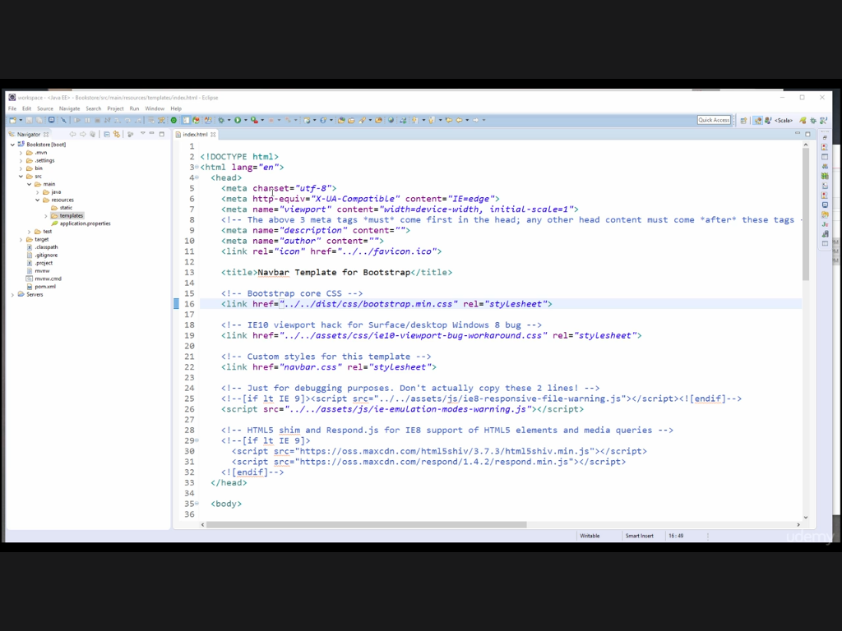
We will be using Thymeleaf as a template engine.
So it requires all elements to be well formed.
Notes:
Thymeleaf is a Java XML/XHTML/HTML5 template engine that can work both in web (Servlet-based) and non-web environments. It is better suited for serving XHTML/HTML5 at the view layer of MVC-based web applications, but it can process any XML file even in offline environments.

Slide 36
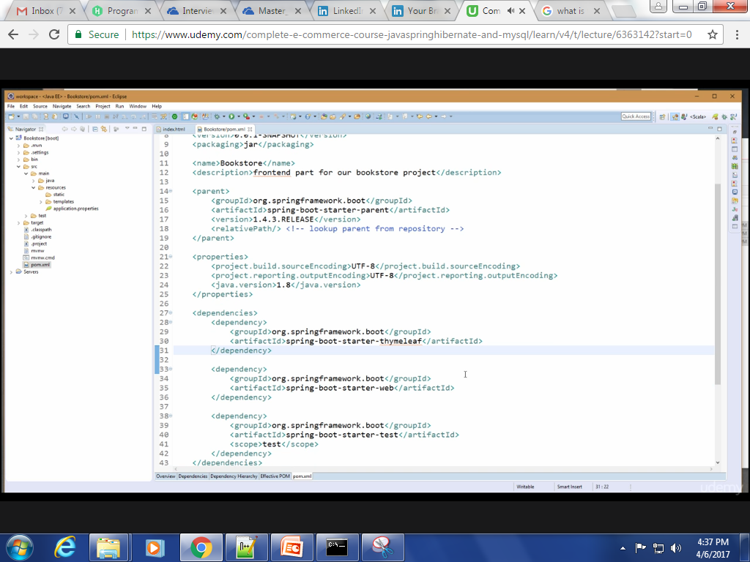

Slide 37
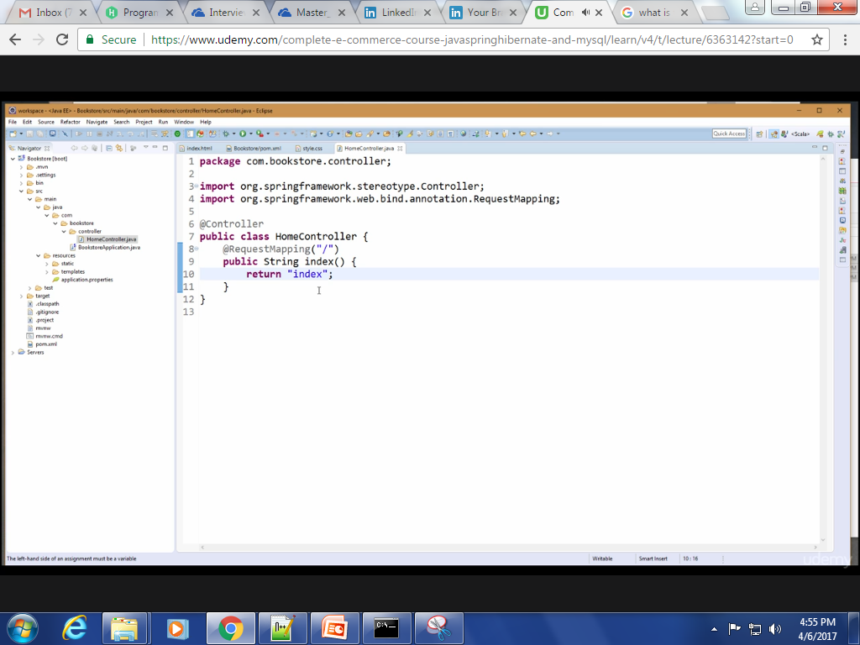

Slide 38
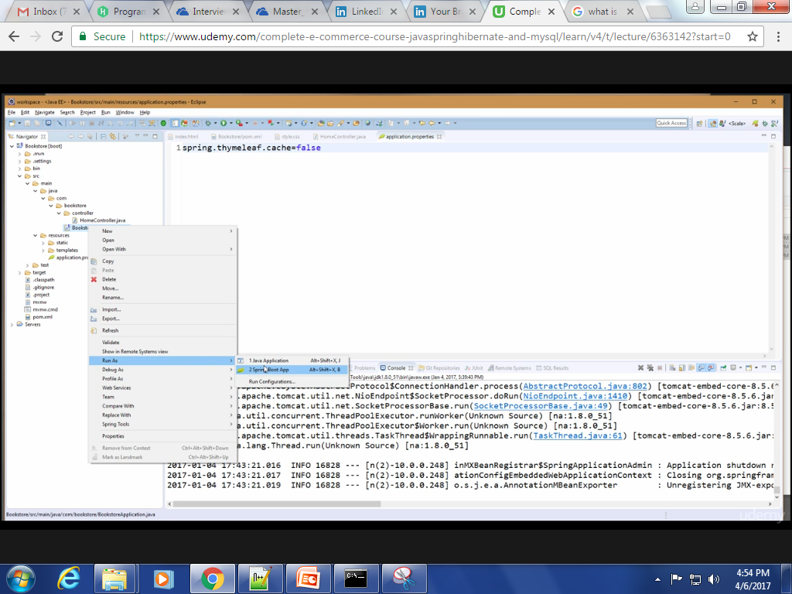

Slide 39
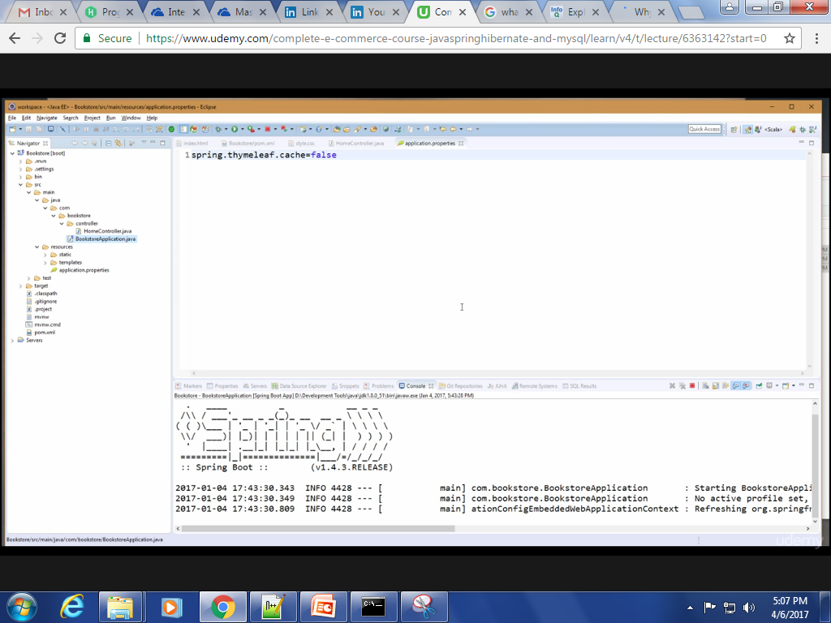

Slide 40
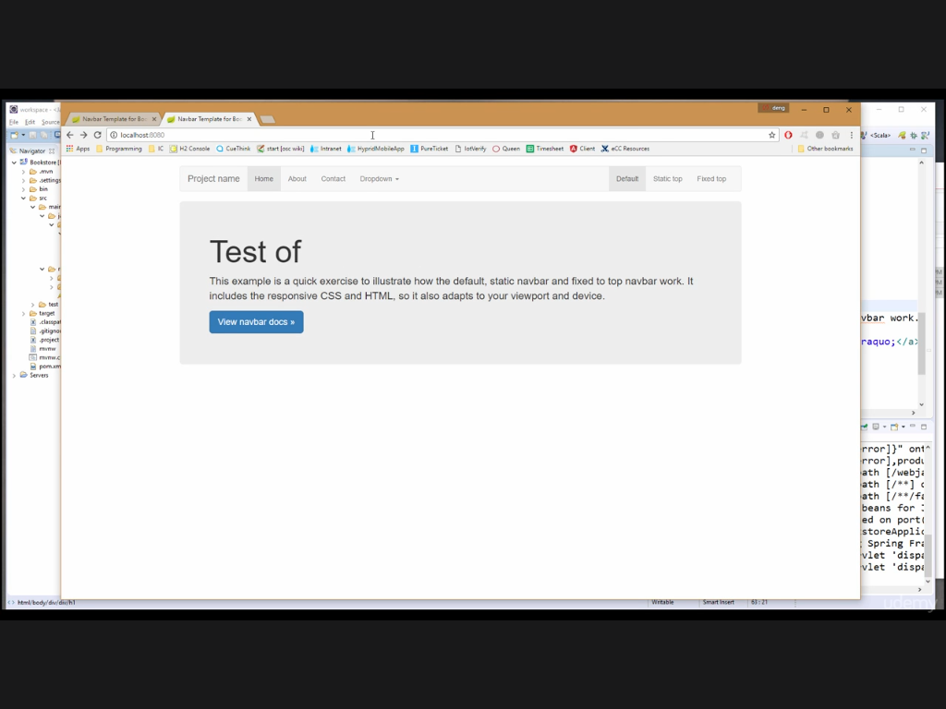

Slide 41
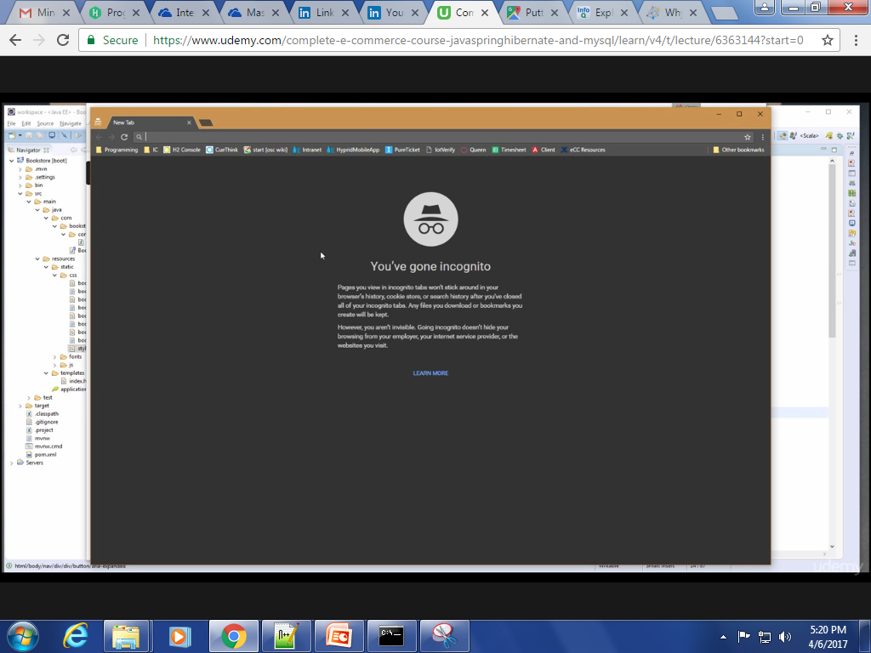

Slide 42
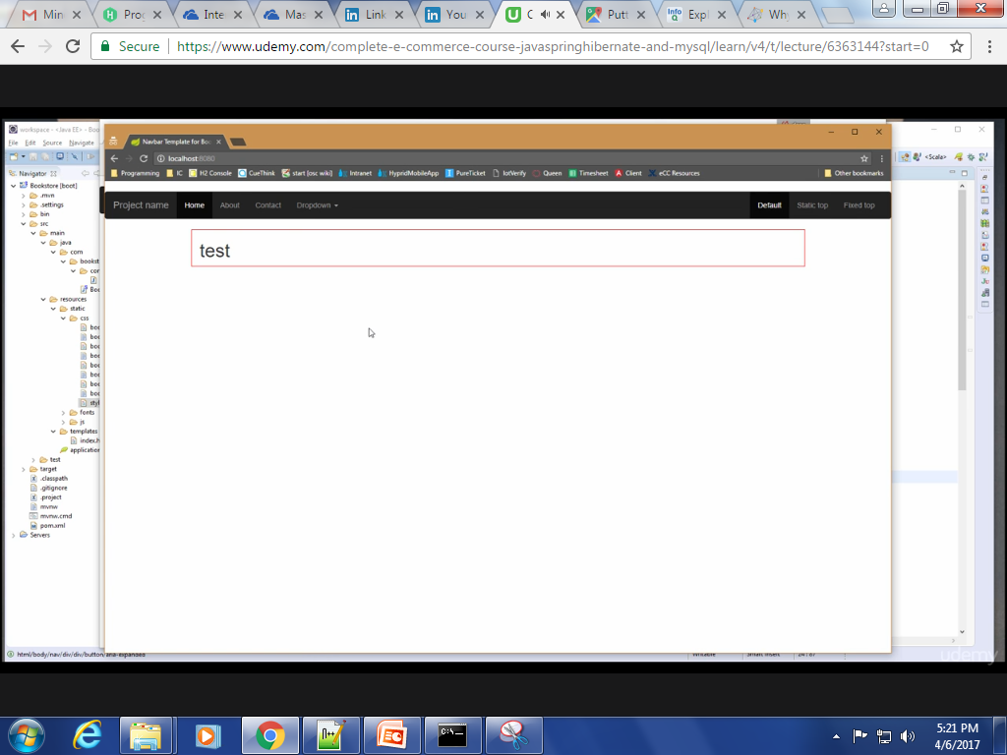
Adding Carousel in Index Page

Slide 43
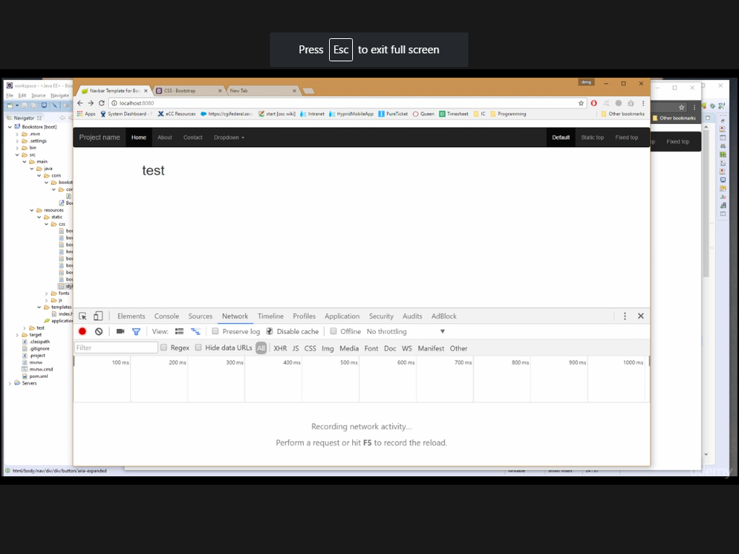

Slide 44
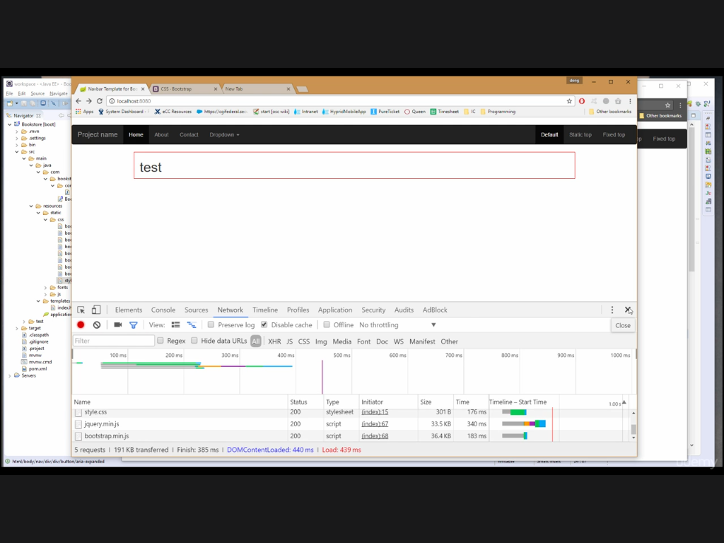

Slide 45
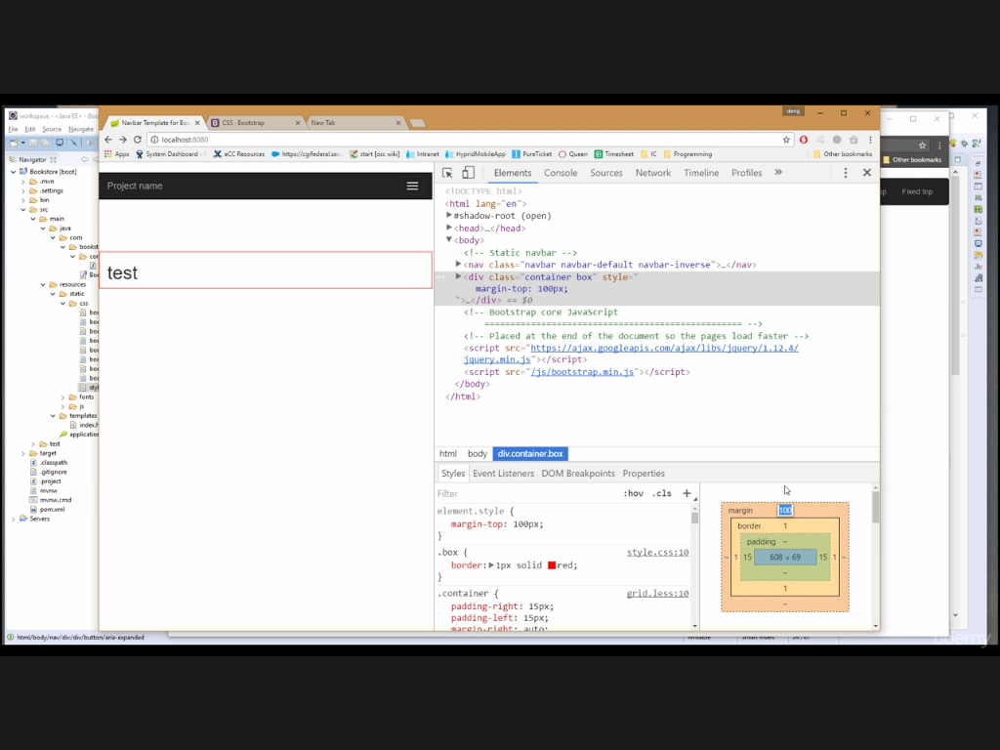

Slide 46
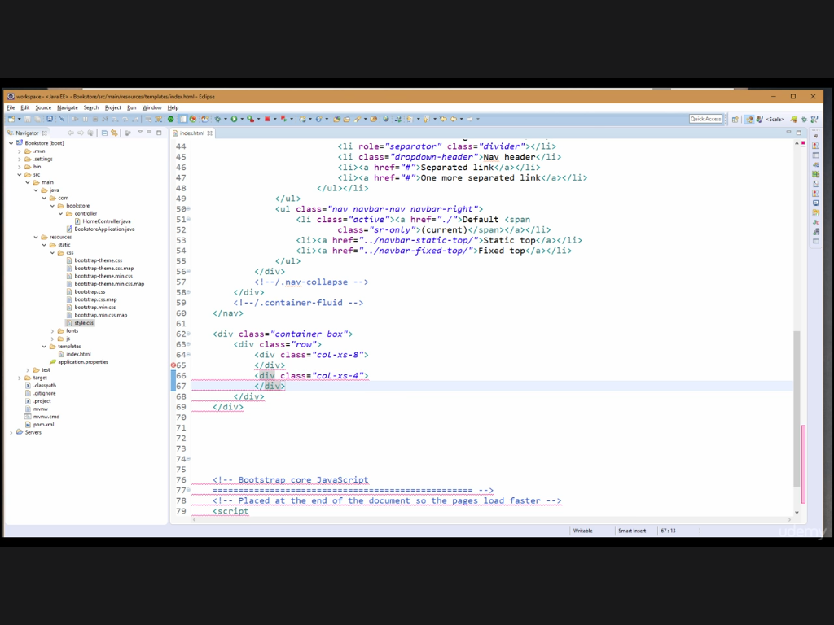
Add Carousel here.

Slide 47
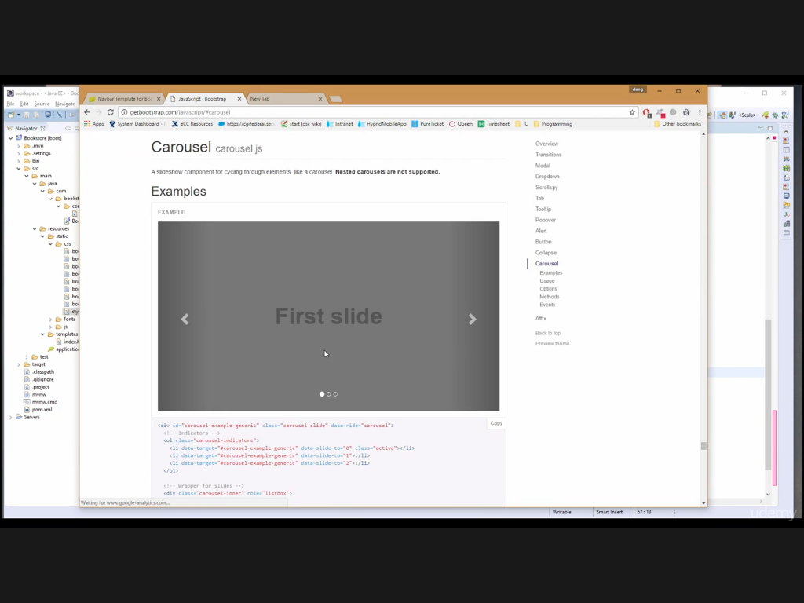

Slide 48
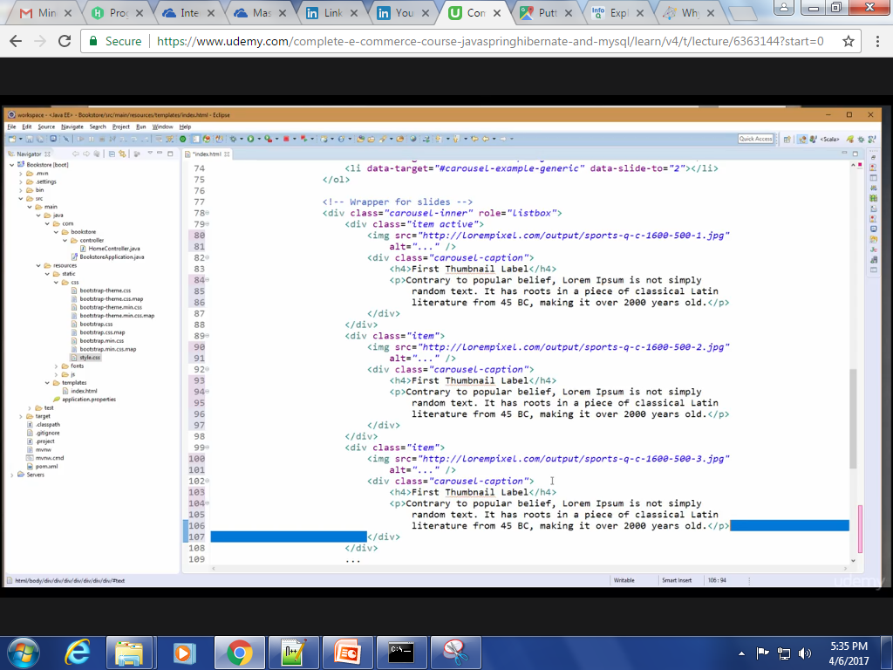

Slide 49
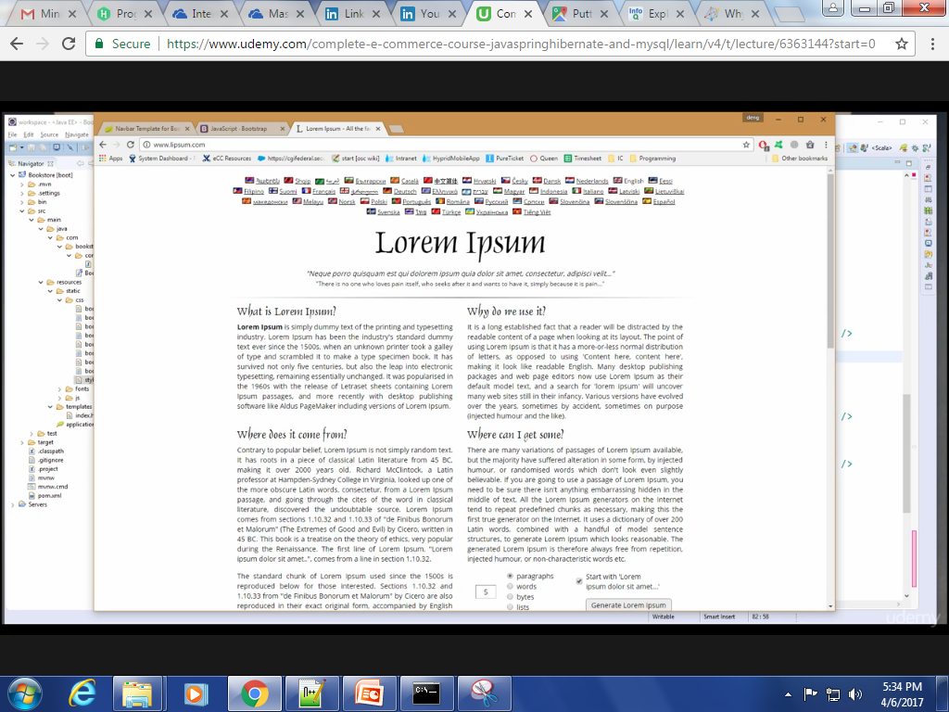

Slide 50
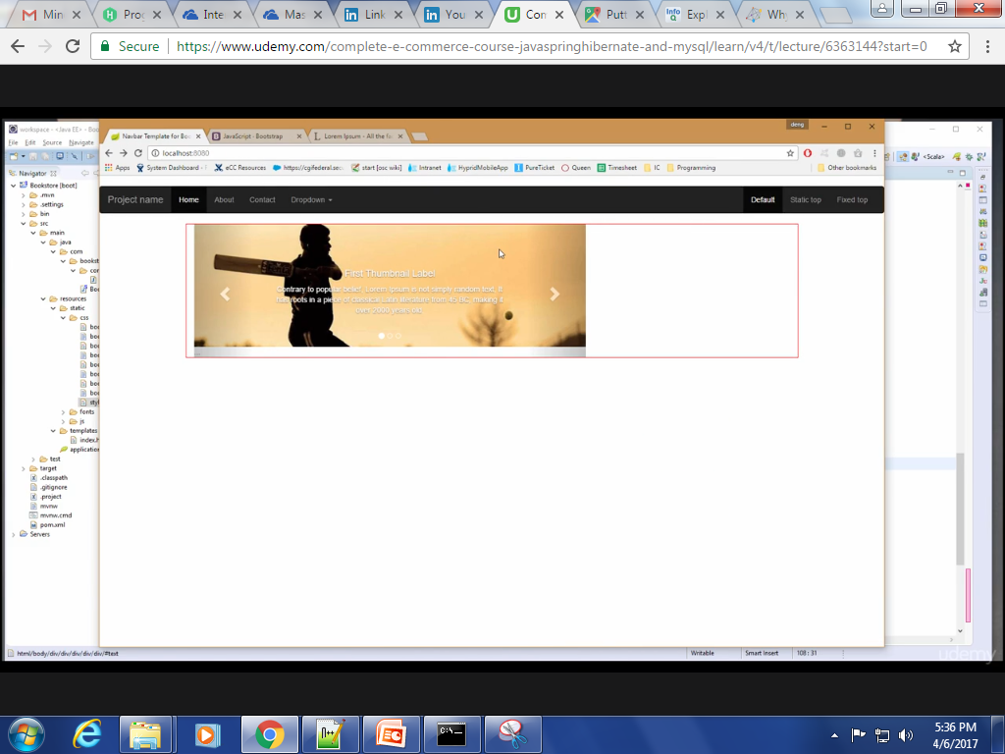
Output

Slide 51
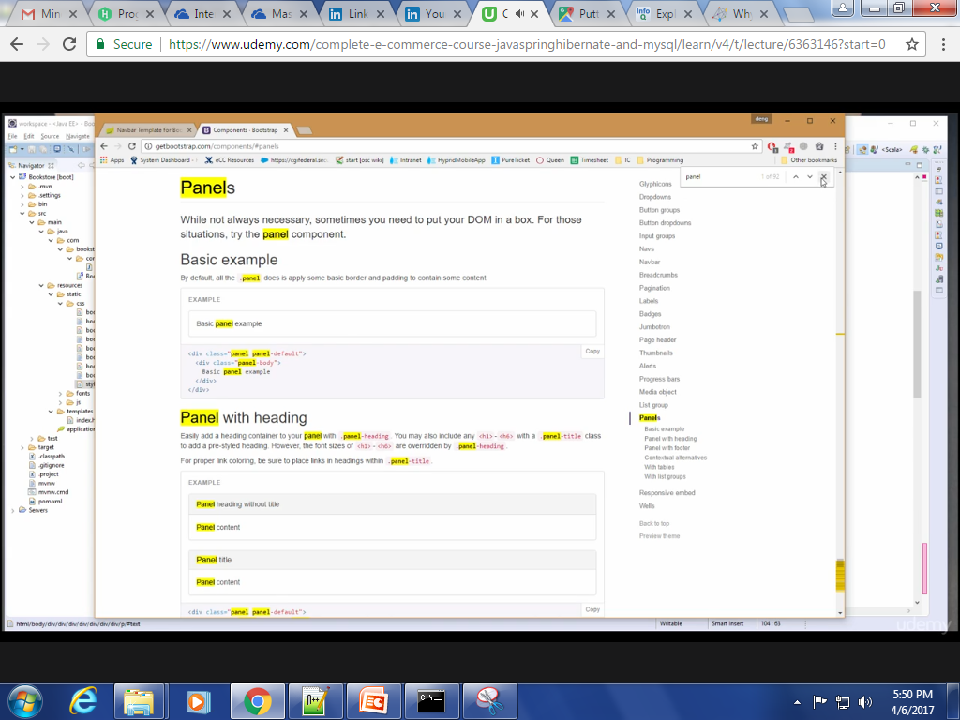
Adding More Pictures

Slide 52
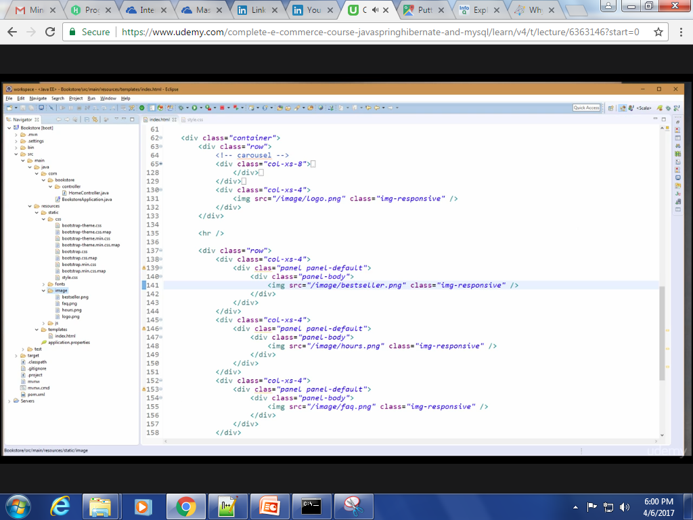

Slide 53
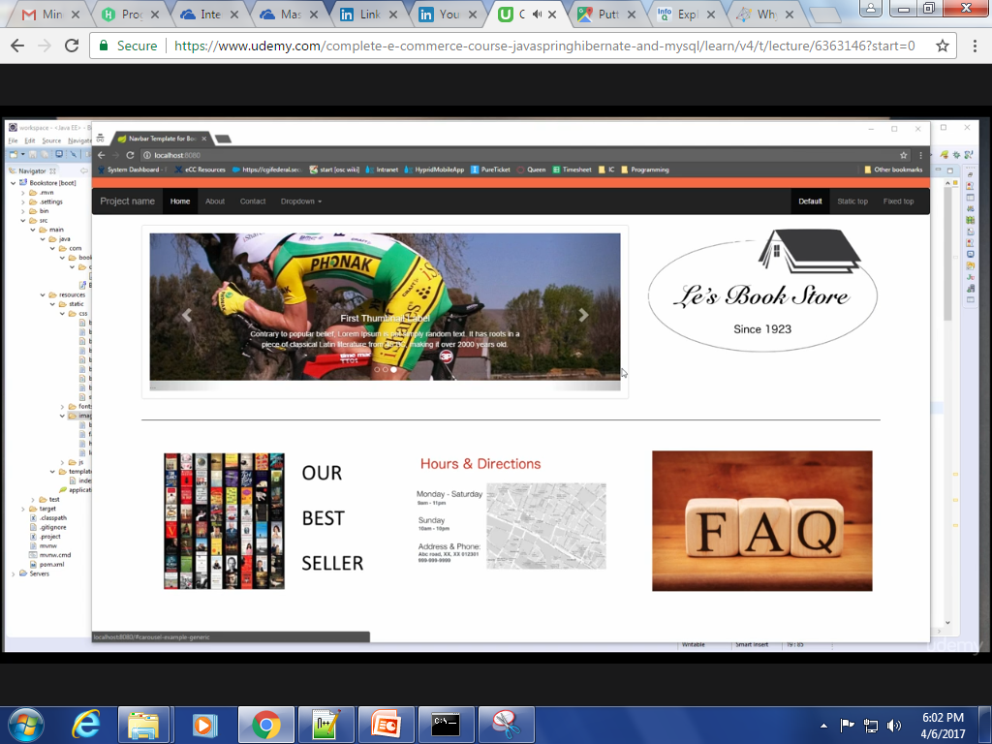

Slide 54
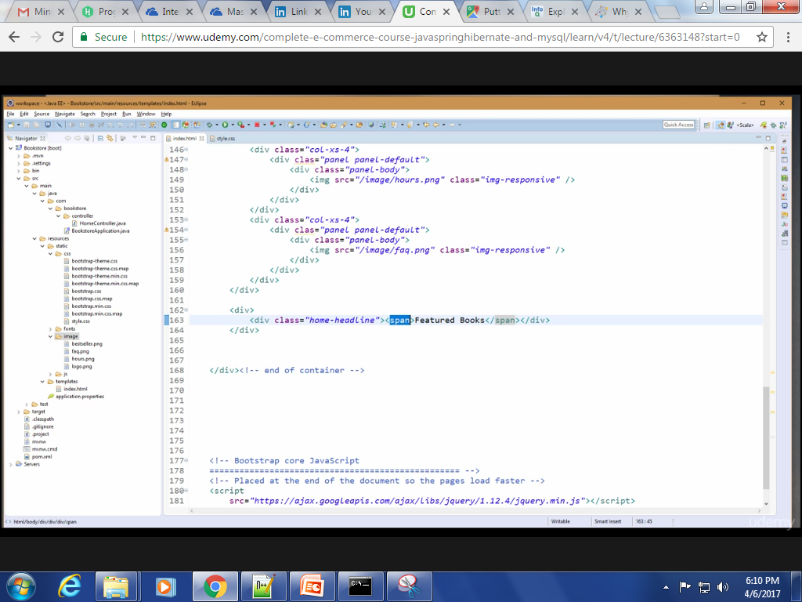
Adding Featured-books and Non-Responsive CSS

Slide 55


Slide 56


Slide 57


Slide 58


Slide 59


Slide 60

If we shrink the browser our
Webpage will not shrink.
For inserting image in tab.

Slide 61

Navbar

Slide 62


Slide 63

Nav Bar code modification

Slide 64

Nav Bar contents are modified.

Slide 65

Adding Common Part of Template
Create header.html under commons folder as shown below.

Slide 66

Contents of header.html

Slide 67

More code here…..

Slide 68

Contents of header.html

Slide 69


Contents from index.html
Rest of the contents in index.html is not having any change.

Slide 70

Nothing will change, that means our common part is working fine.

Slide 71
My Account
Section 3

